Slide 1
SQL- PROJECT

Slide 2
PROJECT OVERVIEW
OBJECTIVE OF THE PROJECT:
Track vaccination progress over time, identifying trends in first and second dose administration across different states.
Analyze vaccinations based on age groups and gender to understand distribution patterns among different populations.
Compare the administration of Covaxin, Covishield, and Sputnik V to determine which vaccines were most widely used.
Evaluate vaccination coverage across different states and at the national level to assess the overall impact of the vaccination drive.
DATASET OVERVIEW:
Dataset name: covid vaccination statewise
Key Columns: Updated On,State, Total Doses Administered,First Dose Administered,Second Dose Administered
TOOLS USED :
Database: MYSQL for querying and analysis.
Visualization: Power Point For Presenting Insights.
KEY ANALYSIS QUESTIONS:
Which states have administered the highest number of total vaccine doses?
What is the ratio of first-dose to second-dose administration across different states?
How many doses of Covaxin, Covishield, and Sputnik V have been administered in each state?
What is the percentage distribution of vaccines administered to males, females, and transgender individuals?
How does vaccine distribution vary among different age groups (18-44, 45-60, 60+ years) in various states?

Slide 3

Which states have administered the highest number of total vaccine doses?
SELECT State, SUM(`Total Doses Administered`) AS Total_Vaccinations FROM covid_vaccine_statewise
GROUP BY State
ORDER BY Total_Vaccinations DESC;
Sample output:
Maharashtra: 3,497,245,000 doses

Slide 4

What is the ratio of first-dose to second-dose administration across different states?
SELECT State,
SUM(`First Dose Administered`) AS Total_First_Dose, SUM(`Second Dose Administered`) AS Total_Second_Dose,
SUM(`First Dose Administered`) / NULLIF(SUM(`Second Dose Administered`), 0) AS Dose_Ratio FROM covid_vaccine_statewise
GROUP BY State
ORDER BY Dose_Ratio DESC;
Sample output:
Dadra and Nagar Haveli and Daman and Diu →
Ratio: 7.31 (33,595,063 first doses, 4,594,416 second doses)
Manipur →
Ratio: 5.68 (67,409,568 first doses, 11,858,150 second doses)

Slide 5
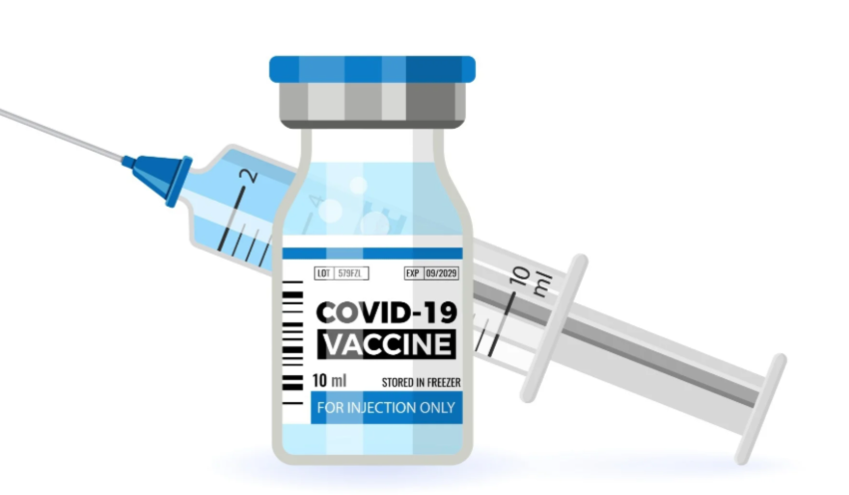
How many doses of Covaxin, Covishield, and Sputnik V have been administered in each state?
SELECT State,
SUM(`Covaxin (Doses Administered)`) AS Covaxin_Doses, SUM(`CoviShield (Doses Administered)`) AS Covishield_Doses,
SUM(`Sputnik V (Doses Administered)`) AS Sputnik_Doses FROM covid_vaccine_statewise
GROUP BY State
ORDER BY Covaxin_Doses DESC;
Sample output: Maharashtra:
Covaxin: 407,481,600 doses
Covishield: 3,084,928,000 doses
Sputnik V: 2,013,538 dose

Slide 6
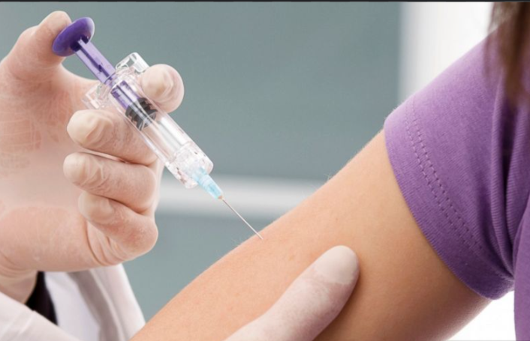
What is the percentage distribution of vaccines administered to males, females, and transgender individuals?
SELECT
SUM(`Male (Doses Administered)`) AS Male_Vaccinated, SUM(`Female (Doses Administered)`) AS Female_Vaccinated,
SUM(`Transgender (Doses Administered)`) AS Transgender_Vaccinated,
(SUM(`Male (Doses Administered)`) / SUM(`Total Doses Administered`)) * 100 AS Male_Percentage, (SUM(`Female (Doses Administered)`) / SUM(`Total Doses Administered`)) * 100 AS
Female_Percentage,
(SUM(`Transgender (Doses Administered)`) / SUM(`Total Doses Administered`)) * 100 AS Transgender_Percentage
FROM covid_vaccine_statewise;
Sample output:
• Male: 38.57%
• Female: 33.76%
Transgender: 0.01%

Slide 7

How does vaccine distribution vary among different age groups (18-44, 45-60, 60+ years) in various states?
SELECT State,
SUM(`18-44 Years (Doses Administered)`) AS Age_18_44, SUM(`45-60 Years (Doses Administered)`) AS Age_45_60, SUM(`60+ Years (Doses Administered)`) AS Age_60_Plus
FROM covid_vaccine_statewise GROUP BY State
ORDER BY Age_18_44 DESC;
Sample output: Uttar Pradesh:
• 18-44 years: 819,763,800 doses
• 45-60 years: 637,573,000 doses
• 60+ years: 430,066,000 doses

Slide 8
THANK YOU

